Slide 1
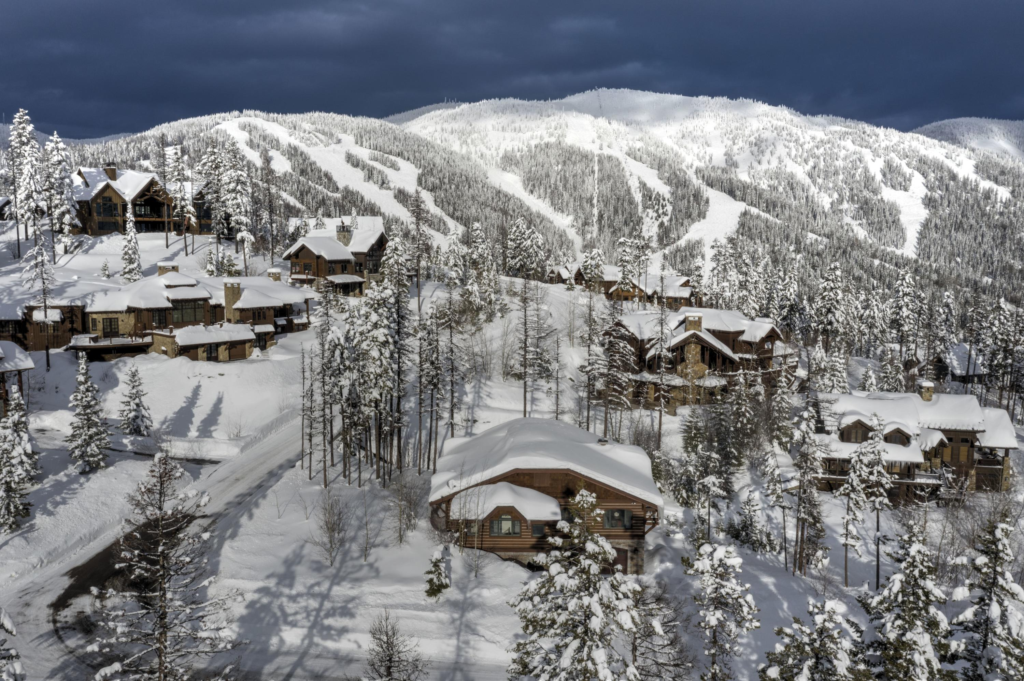
The Big Mountain Resort
Ticket Pricing Predictive Model
July 19th, 2021

Slide 2
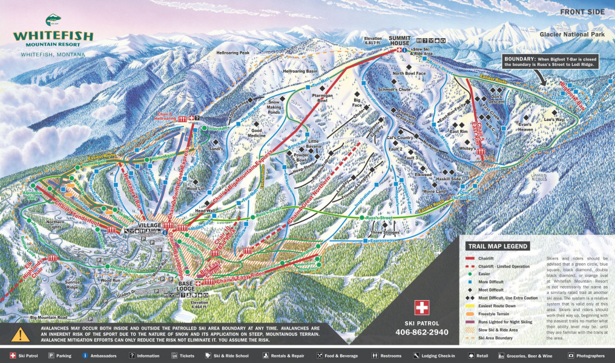
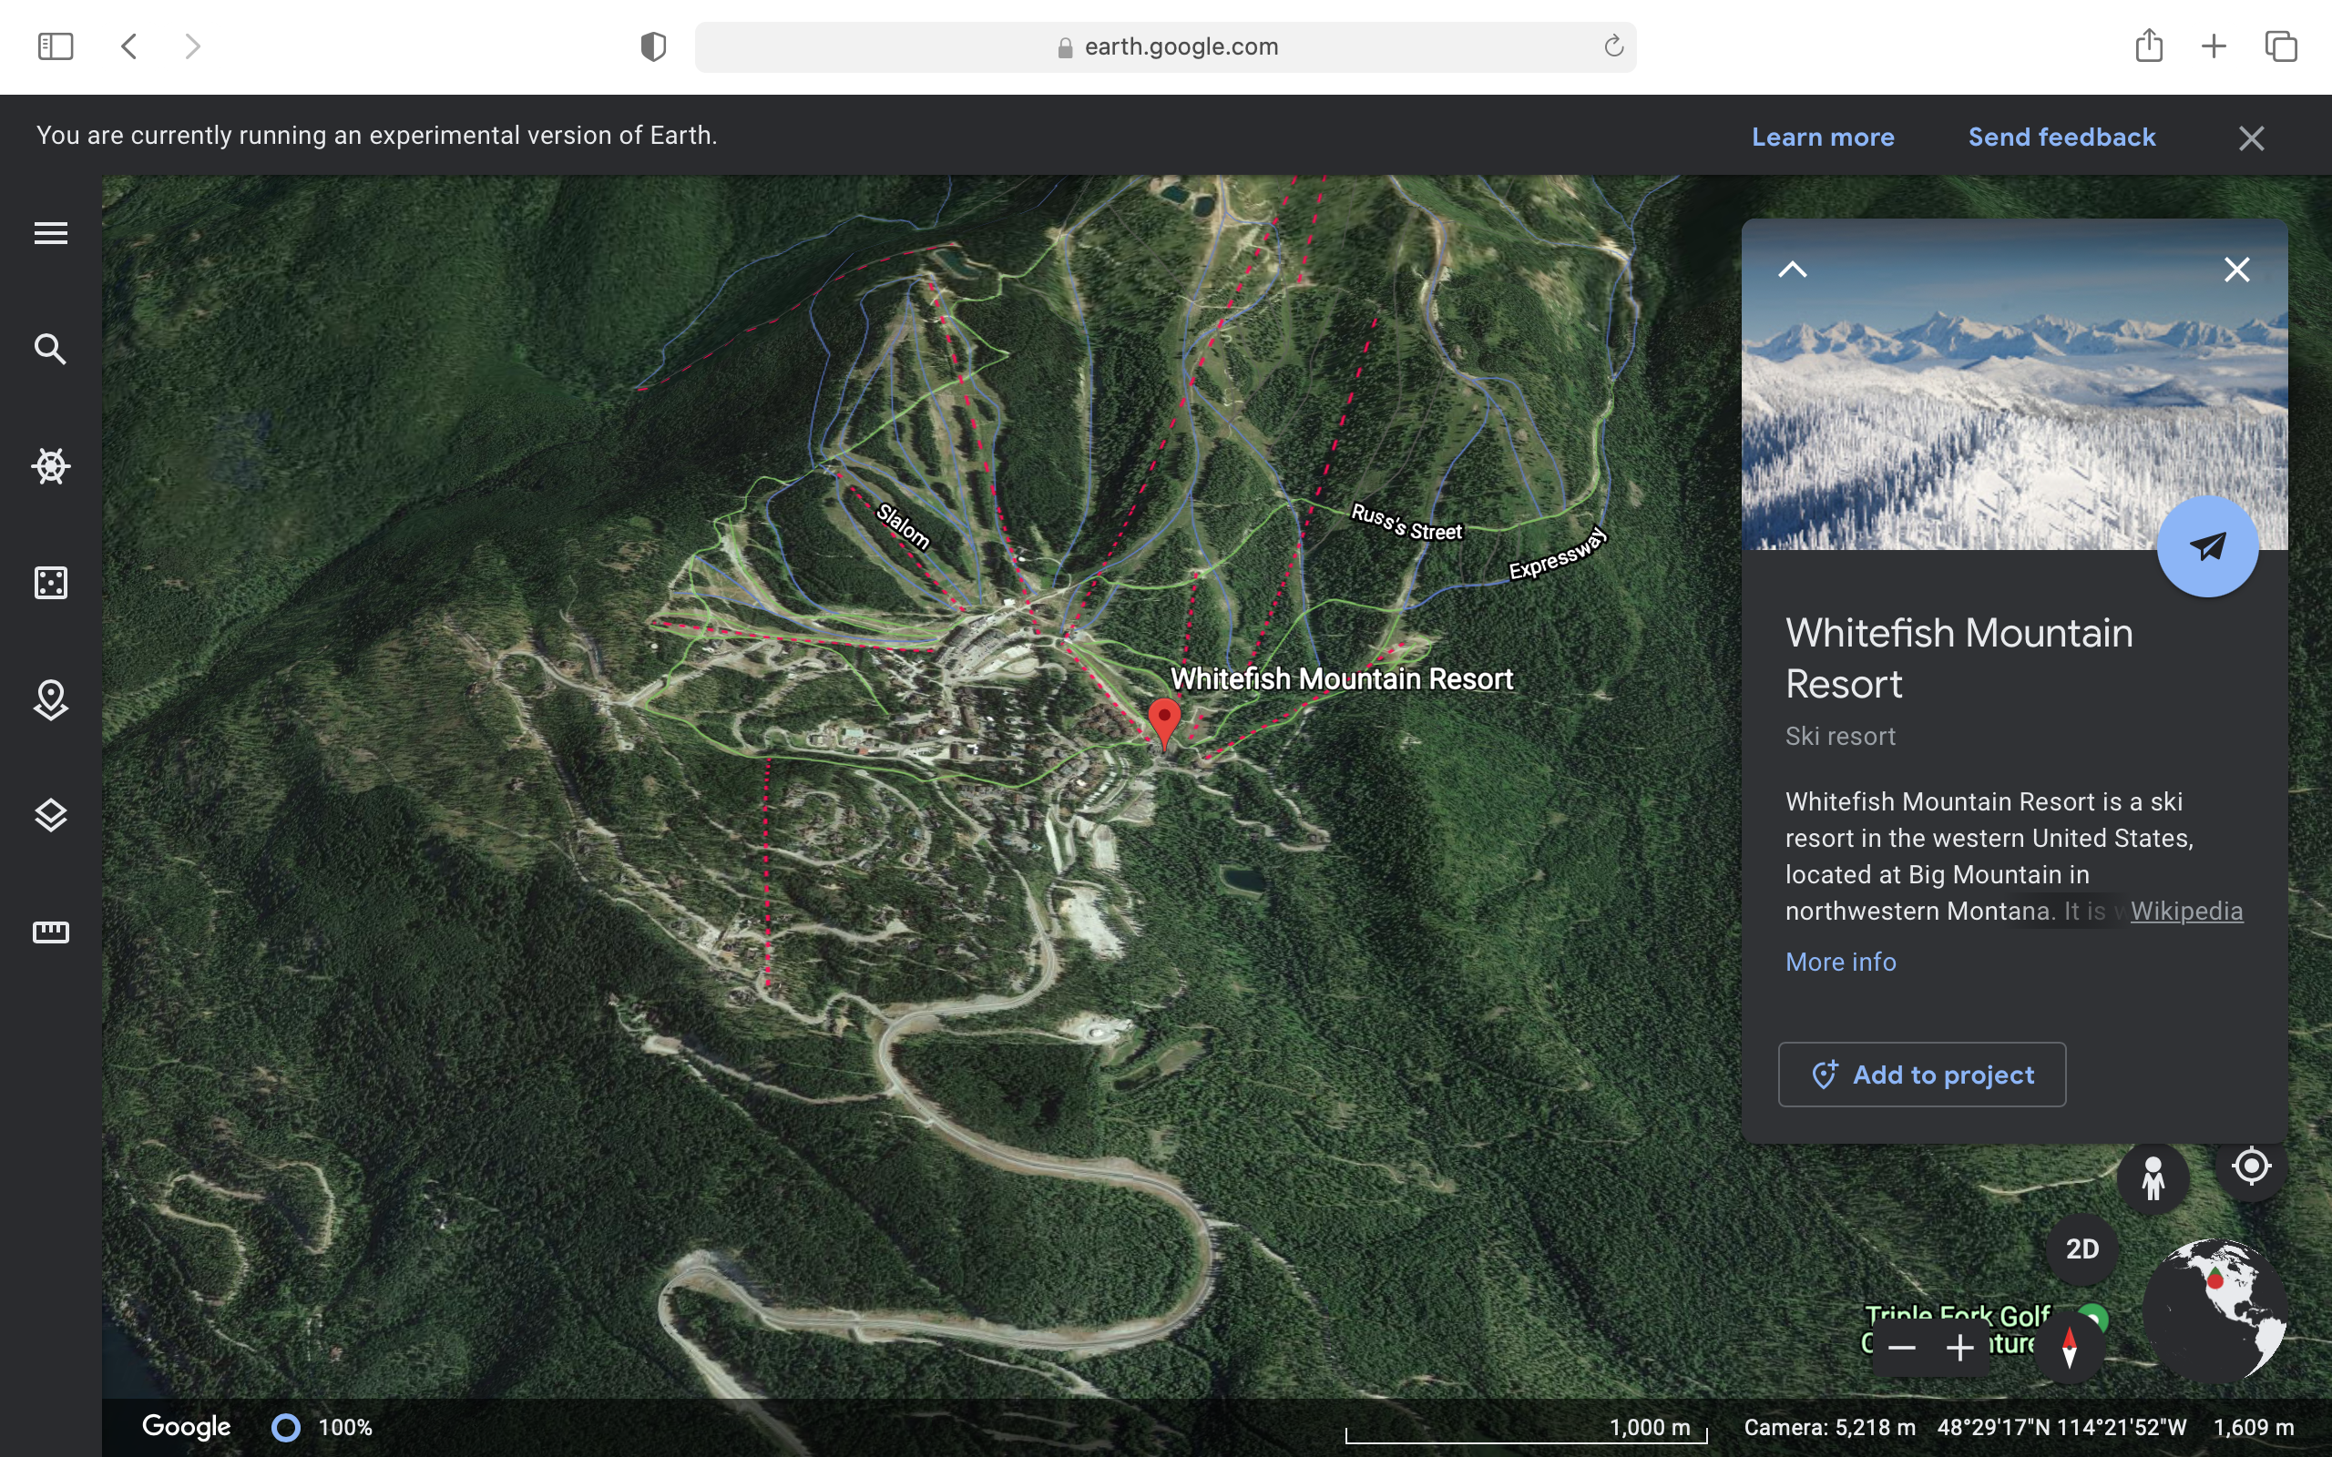
Problem Identification
Big Mountain Resort (aka Whitefish Mountain Resort)
Big Mountain resort bases its ticket pricing on the average price in its market segment
This pricing scheme has two main draw backs
It does not capitalize on the facilities the resort owns
It does not provide an insight on which facilities are important compared to the others which in turn hampers investment strategy

Slide 3
Objectives
The main objectives of this project are:
Build and train a model to predict ticket prices
Use the model to identify features (facilities) that have bigger impact on pricing and those that have minimum impact

Slide 4
Recommendation and key findings
Based on our model, we recommend the following for management to consider:
Increase the ticket prices
The current average ticket pricing scheme is too low. Big Mountain resort possesses facilities that are highly valued by consumers and should take advantage of that
Invest on increasing the vertical drop
This has the highest potential to support higher ticket prices
Close at least one least used run, it has zero impact on ticket pricing
this will save the resort the operational cost for that particular run
There is a potential to close up to 5 runs
This will depend on the operation cost of each run (the information we don’t have currently). If the total operational cost of these 5 runs is greater than the reduction of revenue caused by their closure, then there is a room to increase profit by closing these facilities

Slide 5
Modeling results and analysis
Random forest regression was used to build and train the model
Of the data provided, only 84% was used to build and train the model, the remaining 16% was discarded, as it has missing information
In order to avoid biasing the model by the current pricing scheme, the Big Mountain resort’s information was not included in training the model
the predicted model was validated using different metrics. the final model achieved a mean absolute error of $9.65 and a standard deviation of $1.5

Slide 6
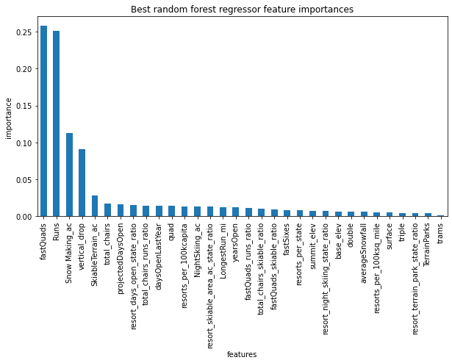
Prediction and scenario testing
Our model predicted a ticket price of $95.87 with an error of +/- $10.39
The predicted price is relatively higher than the current price of $81.
The predicted model also ranked the facilities according to their impact on pricing.

Slide 7
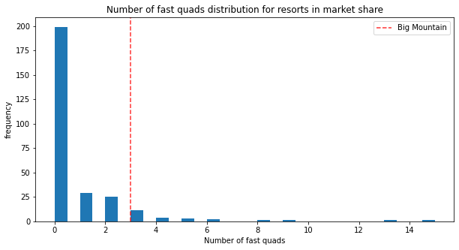
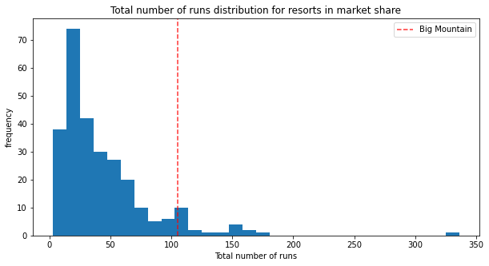
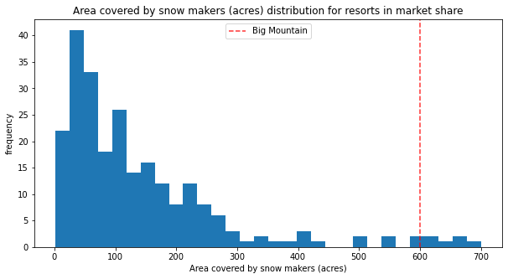
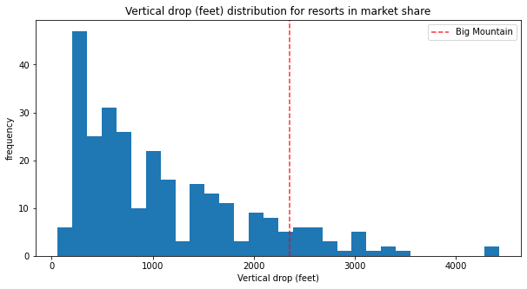
Big Mountain Resort Facilities vs The Competition
Big Mountain’s values for these top features sits at the top of the competition. Hence increasing the ticket price could be justified.

Slide 8
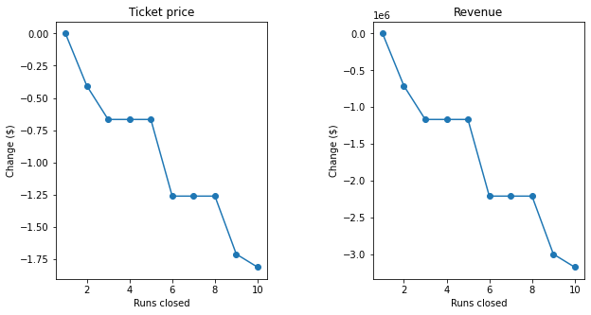
Scenario Testing
Several scenario tests were conducted using the predicted model. the following key assumptions were used to calculate the revenue
350000 visitors per season
On average 5 days of skiing per visitor
Scenario 1 --- Closing up to 10 least used runs
Closing one run does not have any impact on ticket price.
Closing up to 3 runs would reduce the price by ~ $0.7 and the revenue by ~ $1.2M
However closing 3 runs and closing 5 runs have the same impact of pricing and hence Big Mountain may as well close 5 runs instead of 3
Closing 6 or more successively will reduce the ticket price and revenue

Slide 9
Scenario Testing cont.
Scenario 2 --- Increase the vertical drop by 150 feet by adding a run, and installing an additional chair lift
This scenario has a potential to increase the ticket price by $1.99 which resulted on increase in total revenue by $3.5M and adjusted revenue of $1.96M (subtracting the operational cost of the new added chair lift)
Scenario 3 --- The same as scenario 2 but with addition of 2 acres of snow making cover
No impact on ticket pricing
Scenario 4 --- Increase longest run by 0.2 miles and snow making cover by 4 acres
No impact on ticket pricing

Slide 10
Summary and conclusion
Increase the ticket prices. The current average ticket pricing scheme is too low. Big Mountain resort possesses facilities that are highly valued by consumers and should take advantage of that.
Invest on increasing the vertical drop. This has the highest potential to support higher ticket prices.
Close at least one least used run, it has zero impact on ticket pricing and thus will save the resort the operational cost for that particular run.
There is a potential to close up to 5 runs. This will depend on the operation cost of each run (the information we don’t have currently).

Slide 11
Further Work
With all the information at hand (such as operational cost of each facility), Big Mountain management can utilize the model to conducted different combination of scenarios to see their effect on pricing and revenue
This will help the management :
to make strategic decisions to invest on facilities that have positive impact on price
to identify and close certain facilities that have minimum impact on pricing but with high operational cost.

